Slide 1



Mesh Networking Technical Project
Brian Dye
Notes:
In high school, I enjoyed going to Crystal Mountain to go snow boarding in the winter and I also enjoyed going to Moses Lake in the summer to go ATVing
I’m a avid hard rock fan and I grew up admiring the big-name bands that came out of the Seattle

Slide 2
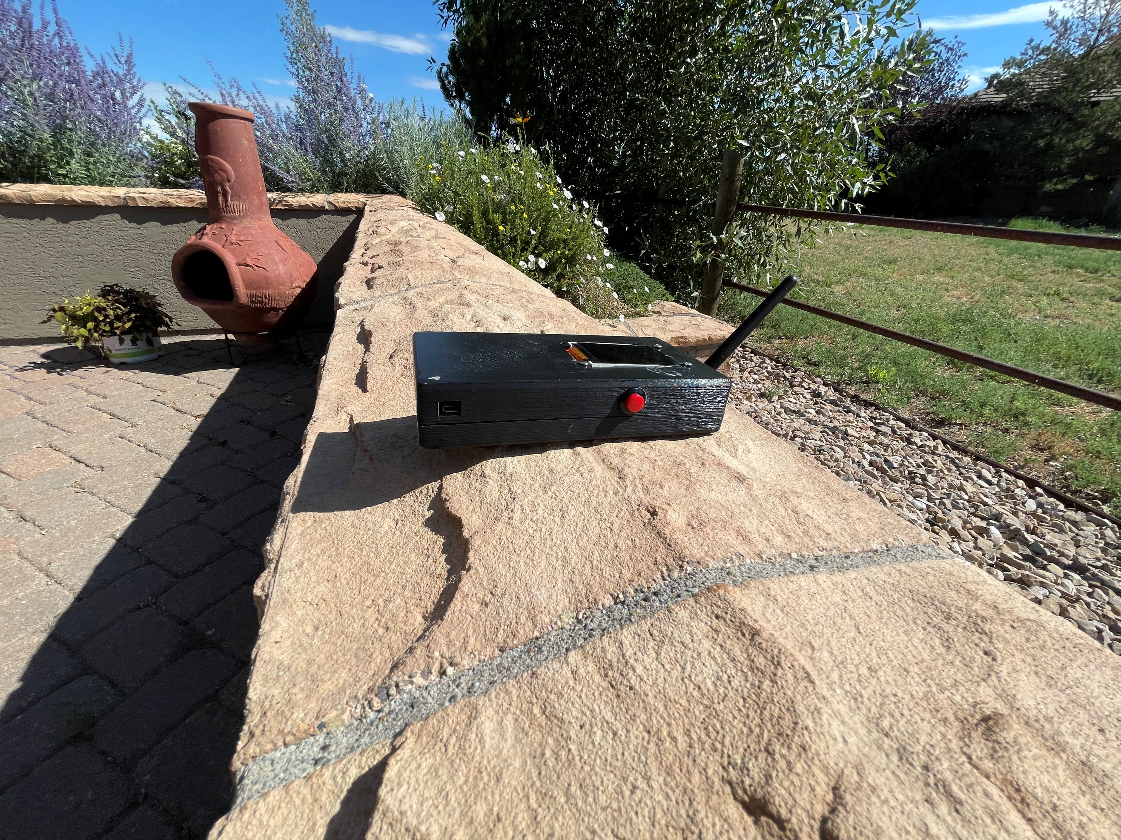
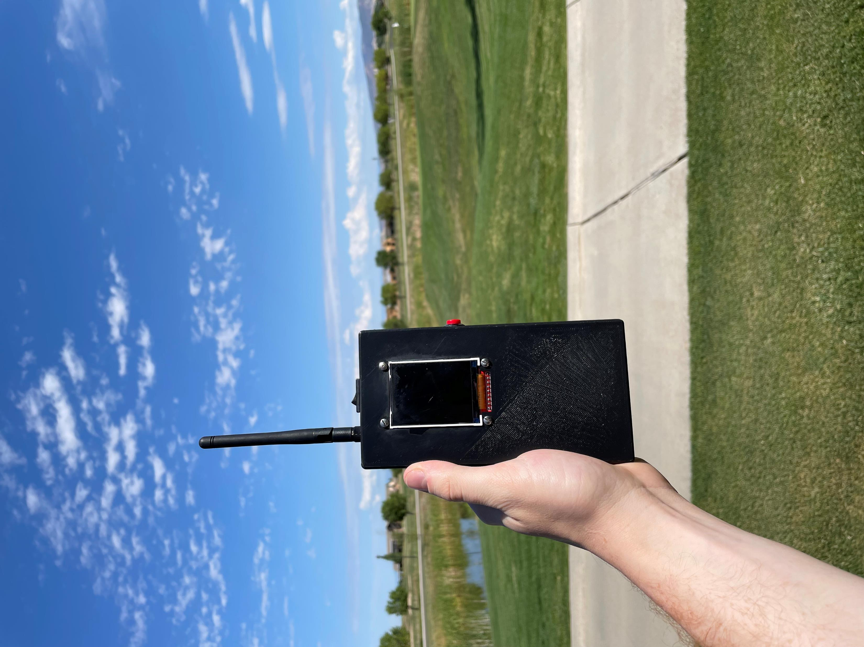
Project Overview
Notes:
The project I’ll be discussing today is a Mobile Ad Hoc Network or Mesh Network
It’s a self forming, self, organizing, mobile network that does not rely on preexisting infrastructure
The primary use case for this application is for providing remote military communications
Users of the network gain access through our progressive web application that provides a Bash-Terminal-Like interface

Slide 3

Hardware Overview
HM-19 Bluetooth module
RFM69HCW Radio module
SPI2 Full Duplex
UART
SparkFun Battery babysitter
3.3V Step-Up/Step-Down Voltage Regulator
SAM-M8Q
GPS module
S9V11F3S5C3
Power Supply
3.3 V
I2C1
STM32
Battery
I2C1
LCD screen
3.7V LiPo Battery
SPI1 Half Duplex
Push Button Interrupt
Modules
Notes:
Throughout this presentation, I’m going to start with a broad, birds-eye overview of a specific subject I’d like to cover, and then dive into the details in following slides

Slide 4
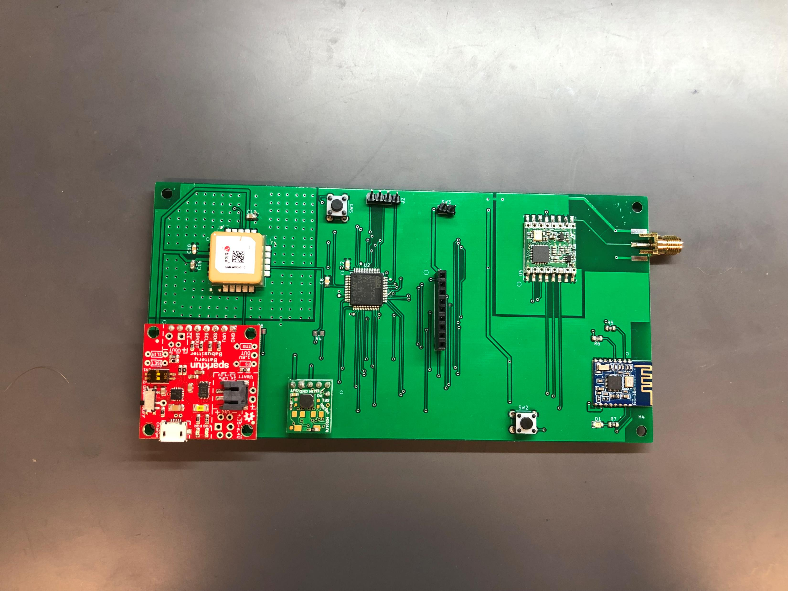
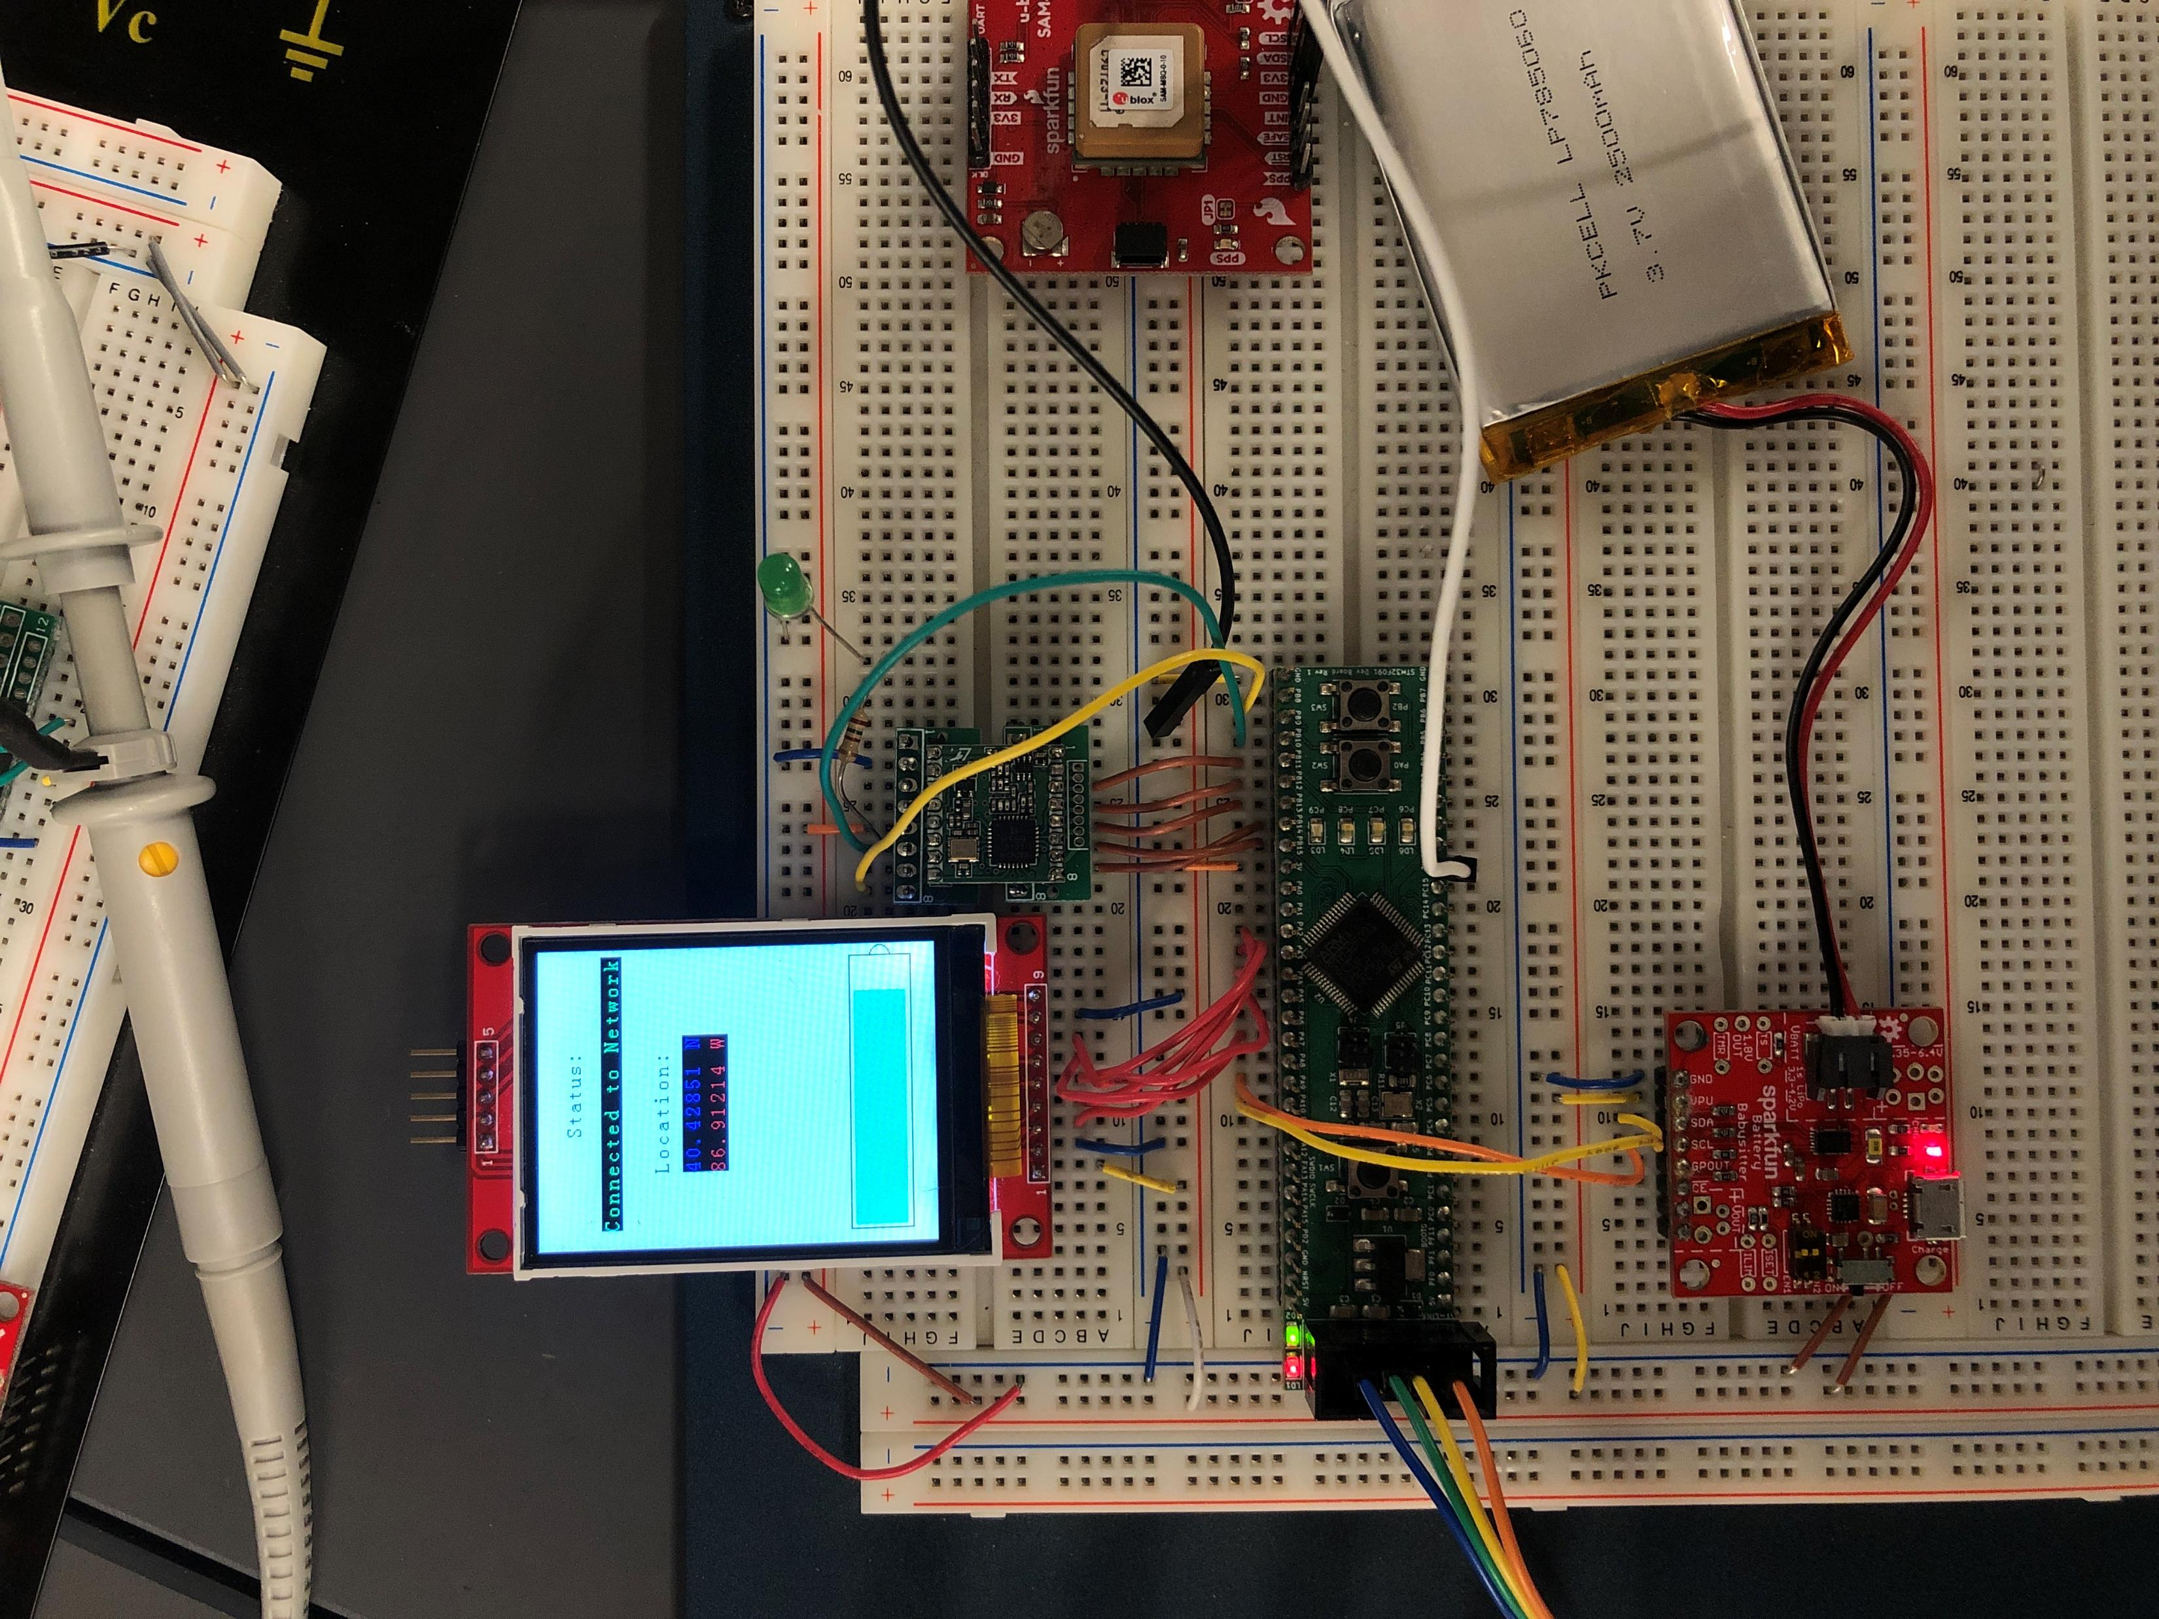
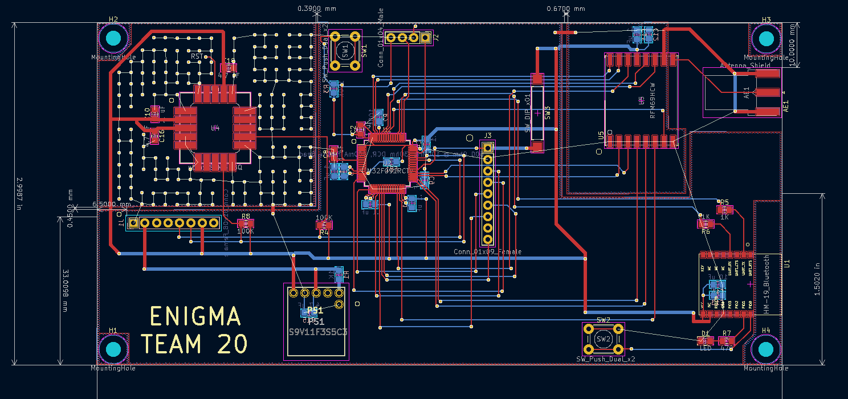
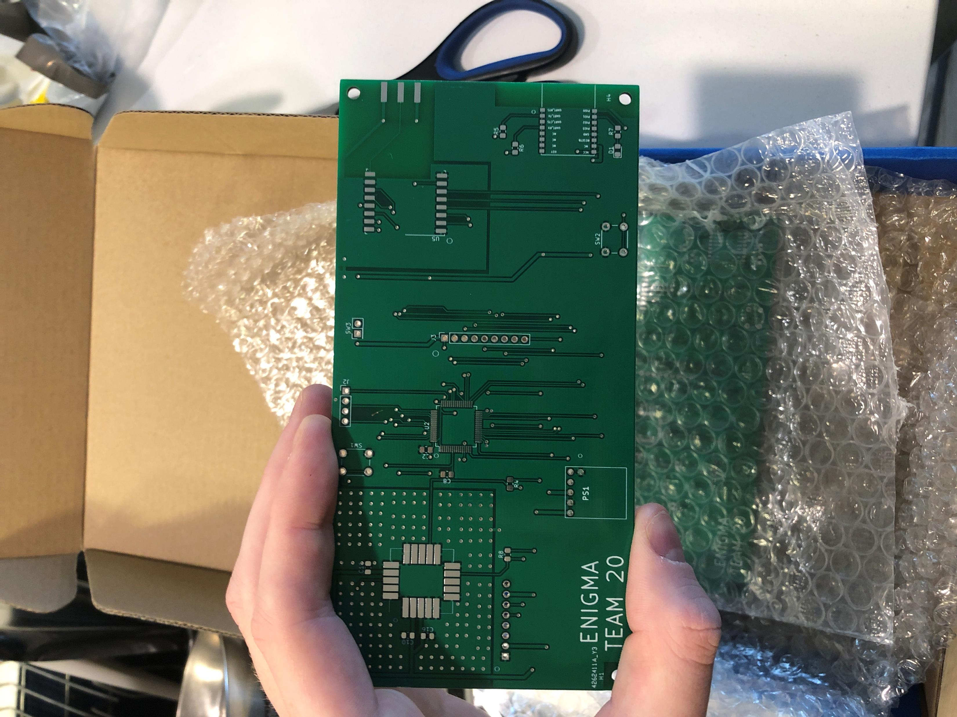
Prototyping & PCB Design
Notes:
Prototyped on bread board
Printed circuit board design in KiCad Software
Reviewed the data sheets and schematics of each module to ensure the electrical specifications were met (capacitors, resistors, ground plane)
Submitted Gerber files of the PCB design to JLC PCB in China (ordered 10 & took 2 weeks to arrive)
Soldered each component onto PCB using FLUX & non-led solder, rinsed the component with Alcohol solution to remove corrosive flux, then washed and scrubbed component with deionized water
Finally, we tested the component using software & bread board prototype

Slide 5
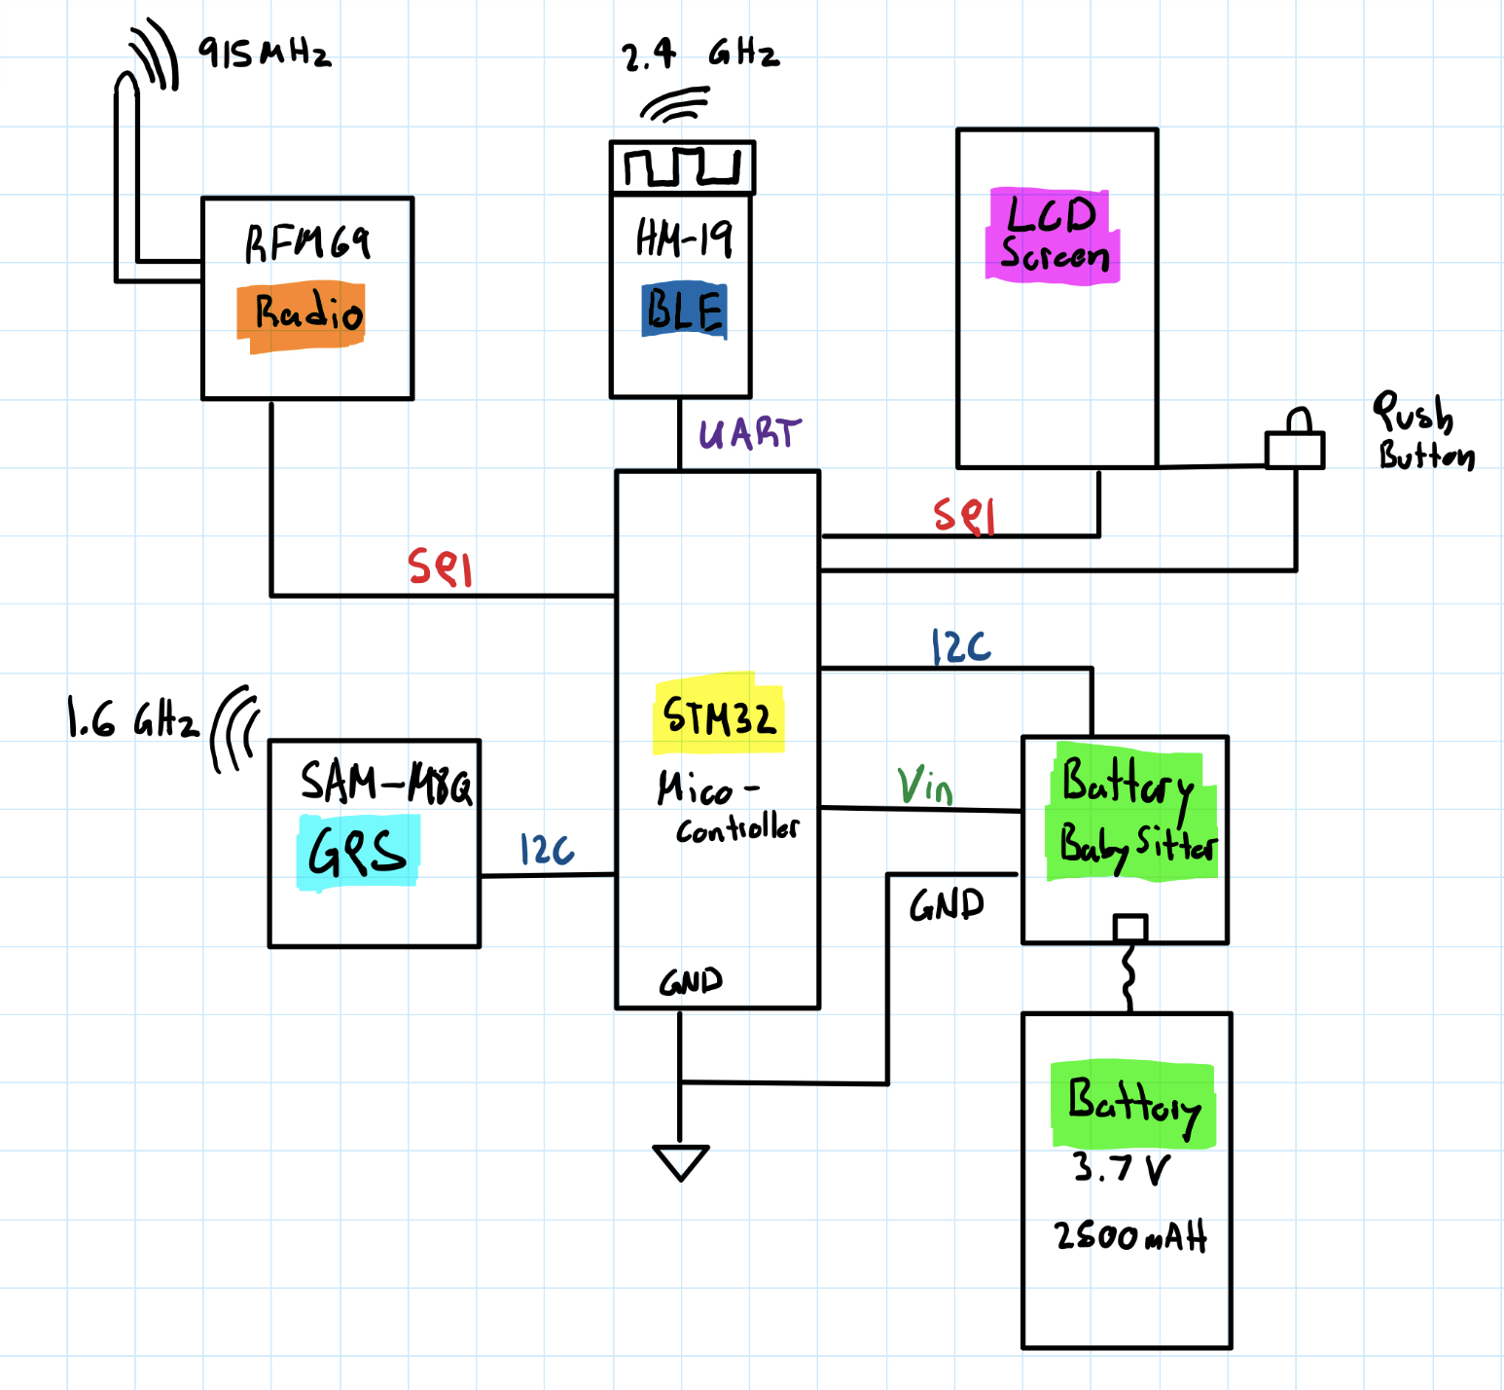
Firmware Development Overview
SPI2
RFM69 Radio
4 MHz clock
Full Duplex
8-bit mode
SPI1
MP2202 TFT Display
4 MHz clock
Half Duplex
8/16-bit mode
I2C1
SAM-M8Q GPS & Babysitter
Fast Mode 400k bits/s
Shared bus
UART
HM-19 Bluetooth module
9600 baud rate
8-bit mode
No stop bit
No parity bit
Over Sample x16
Notes:
As you know, each peripheral has specific requirements in terms of its serial interface requirements and it’s up to the microcontroller to meet those requirements
SPI2 is used for RFM69 and SPI1 is used for the LCD screen.
SPI2 is fully duplex to send data to and from the RFM69
SPI1 is half duplexed because we only needed to send information to the LCD not receive
SPI1 also needed to switch dynamically between byte & word frames depending on if it’s a command or data
SPST Push button external interrupt was used to 1) give power to the LCD screen and 2) send status update to LCD screen (saves power, Single pole Single Throw)
I2C1 bus was shared between the GPS module & Battery Babysitter.
Touch on UART features & radio frequencies

Slide 6
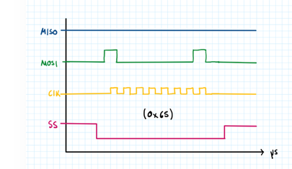
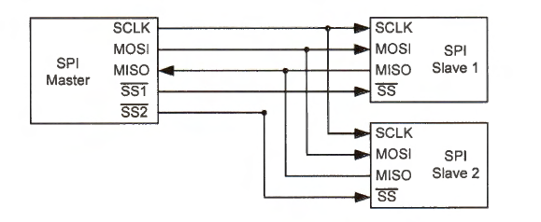
Serial Peripheral Interface API
Function | Purpose
void SPI(SPI_TypeDef * SPIx) | Configure SPIx for SPI1 or SPI2. Clock rate, full or half duplex, NSS management, etc
void SPI_Write(SPI_TypeDef * SPIx, const uint8_t *txBuffer, uint8_t * rxBuffer, int size) | Write size bytes from txBuffer using SPIx and read size bytes into rxBuffer
void SPI_Read(SPI_TypeDef * SPIx, uint8_t *rxBuffer, int size) | read size bytes into rxBuffer using SPIx
Notes:
Configure each SPI1 and SPI2 for the RFM69 and LCD screen respectively. Each require different electrical characteristics that I spoke about earlier
* Touch on SPI write and Read

Slide 7
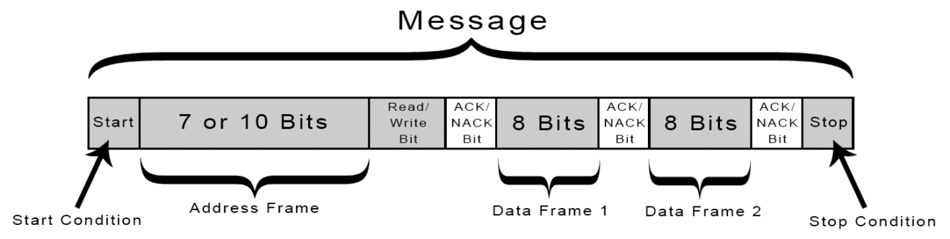
Inter-Integrated Circuit API
Function | Purpose
void I2C_Initialization(I2C_TypeDef * I2Cx) | Configure I2Cx. Fast mode, clock prescaler, data setup time, data hold time, SCLL, SCLH
int8_t I2C_Send(I2C_TypeDef * I2Cx, uint8_t SlaveAddress, void *pdata, uint8_t nBytes) | Write nBytes of pdata to SlaveAddress using I2Cx. Return 1 on success and -1 otherwise
int8_t I2C_Receive(I2C_TypeDef * I2Cx, uint8_t SlaveAddress, uint8_t *pData, uint8_t nBytes) | Read nBytes from SlaveAddress using I2Cx into pData. Return 1 on success and 0 otherwise
void I2C_WaitLineIdle(I2C_TypeDef * I2Cx) | Wait until I2Cx bus is idle
void I2C_Stop(I2C_TypeDef * I2Cx) | Generate STOP bit
void I2C_Start(I2C_TypeDef * I2Cx, uint32_t DevAddress, uint8_t nBytes, uint8_t Direction) | Start an nByte I2Cx communication with DevAddress in Direction (0=Write, 1=Read)
int I2C_CheckNack(I2C_TypeDef * I2Cx) | Check if NACK (no acknowledge) was received
void I2C_ClearNack(I2C_TypeDef * I2Cx) | Clear the NACK bit in control register
Notes:
I2C configuration MUST accommodate the Electrical characteristics of BOTH GPS and Battery Babysitter (data setup time, data hold time, SCLL, SCLH)
I2C API was created based on the functional foundation of I2C (Start, Stop, Wait for the line to be idle, Check/Clear NACK)
I2C Send:
Wait for Line to be idle
I2C Start
Write nBytes of pdata
Wait until Transmit complete flag or NACK was received
If NACK was received return -1 (Failure)
STOP I2C
I2C Send follows a similar pattern

Slide 8
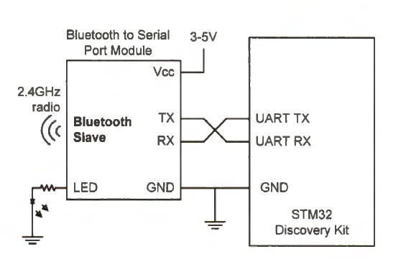
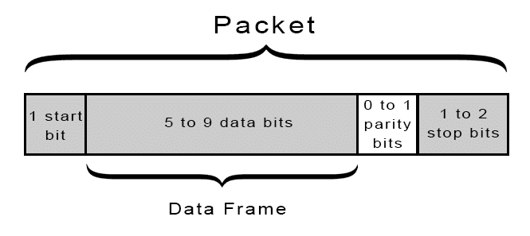
Universal Asynchronous Receiver & Transmitter API
Function | Purpose
void USART(USART_TypeDef *USARTx) | Configure USART4 for HM-19 Bluetooth module & Direct Memory Access
void USART4_Write (uint8_t *buffer, uint32_t nBytes) | Synchronously Write nBytes of buffer using USART4
void DMA_Transmit(uint8_t *pBuffer, uint8_t size) | Use DMA1 Channel 7 to transmit size bytes of pBuffer using USART4
Notes:
The USART API follows a similar trend to SPI and I2C (read & write), however data from the Bluetooth module to the STM32 processor must be transferred ASYNCHROUSLY
Meaning: The user (Connected Bluetooth Device) can request or send data over the network anytime they want
DMA interrupt RECEIVE is generated upon transfer

Slide 9
Software Overview
Write Packet via UART
Read Battery Level
Read GPS Coordinates
Send Control Packet
RFM69 Fetch Packet
Received Packet
Packet is for us
Periodic 6 seconds
Initialization
Forward
STP
WFI
Handle Packet
Control Packet
User Pushed Button
User Requests Information
Packet is not for us
Send Info via UART
Write status to LCD via SPI
Route
Data
Notes:
Initialize the Serial Communication Protocols using the Firmware APIs I developed above
Initialize the Peripheral Devices (RFM69 characteristics, Reset the HM-19 Bluetooth module etc)
Setup and enable the interrupts
4 interrupts total
1 Synchronous & periodic timer interrupt that occurs every 6 seconds
3 Asynchronous:
RFM69 has received a packet
User pushes button for status update to LCD screen
User requests information or access to send data into network
* Touch on Handle Packet

Slide 10
Interrupt Service Routine API
Interrupt Description | Priority | Purpose
Periodic 6 second timer | 3 | Fetch Battery Level Fetch Coordinates Send Control Packet
RFM69 radio has received a packet (External Interrupt) | 1 | Fetch packet from RFM69 Handle received packet
User push button (External Interrupt) | 1 | Write the following to TFT screen Network status Current geographical Coordinates Current battery level
Connected device request a node status OR access to network (DMA receive interrupt) | 2 | Connected Device can request the following Current Battery level Forwarding table Current GPS coordinates Send a UDP packet into network
Notes:
Touch on descriptions
Touch on why you choose priorities

Slide 11
RFM69HCW Radio API
Function | Purpose
uint8_t RFM69_initialize(uint8_t nodeID, uint16_t networkID) | Configure RFM69HCW via SPI2
RFM69_handleReceivedPacket(uint8_t * packet) | Fetch a received packet from the RFM69
void RFM69_sendPacket(uint8_t RFM_targetID, uint8_t packetType, uint8_t* packet, uint8_t packetSize) | Send packetSize bytes of packetType packet to RFM_targetID
void RFM69_setMode(uint8_t newMode) | Set RFM69 mode: Send, Receive, Standby, Sleep etc
void RFM69_setPowerLevel(uint8_t powerLevel) | Set the transmit power level 0=min 31=max
int16_t RFM69_readRSSI(uint8_t forceTrigger) | Read the received signal strength indicator
uint8_t RFM69_readReg(uint8_t addr) | Read the RFM69 register value at addr
void RFM69_writeReg(uint8_t addr, uint8_t value) | Write value to RFM69 addr register
Notes:
The RFM69 radio is the primary radio for node-to-node communication
It has a sophisticated interface to utilize its primary functionality (send and receive packets)
To develop the higher-level software interface for the RFM69, I once again used a foundation approach
First, I created the functions that enabled a read and write of a memory location within the RFM69’s memory mapped I/O
Then I built helper functions on top of them (read RSSI, Set Mode, Set power level)
Finally, functions such as send packet and handle received packet rely on these helper functions which is primary function of the RFM69

Slide 12
SAM-M8Q GPS API
Function | Purpose
uint8_t get_coord(char * lat, char * lon) | Fetch the current latitude and longitude coordinates. Return 1 on success and 0 on failure
Sparkfun Battery Babysitter API
Function | Purpose
uint16_t StateOfCharge(void) | Return the current battery level as an unsigned 16-bit integer
Notes:
The SAM-M8Q GPS and Sparkfun Battery Babysitter have a much simpler interface. Only one function for each module

Slide 13
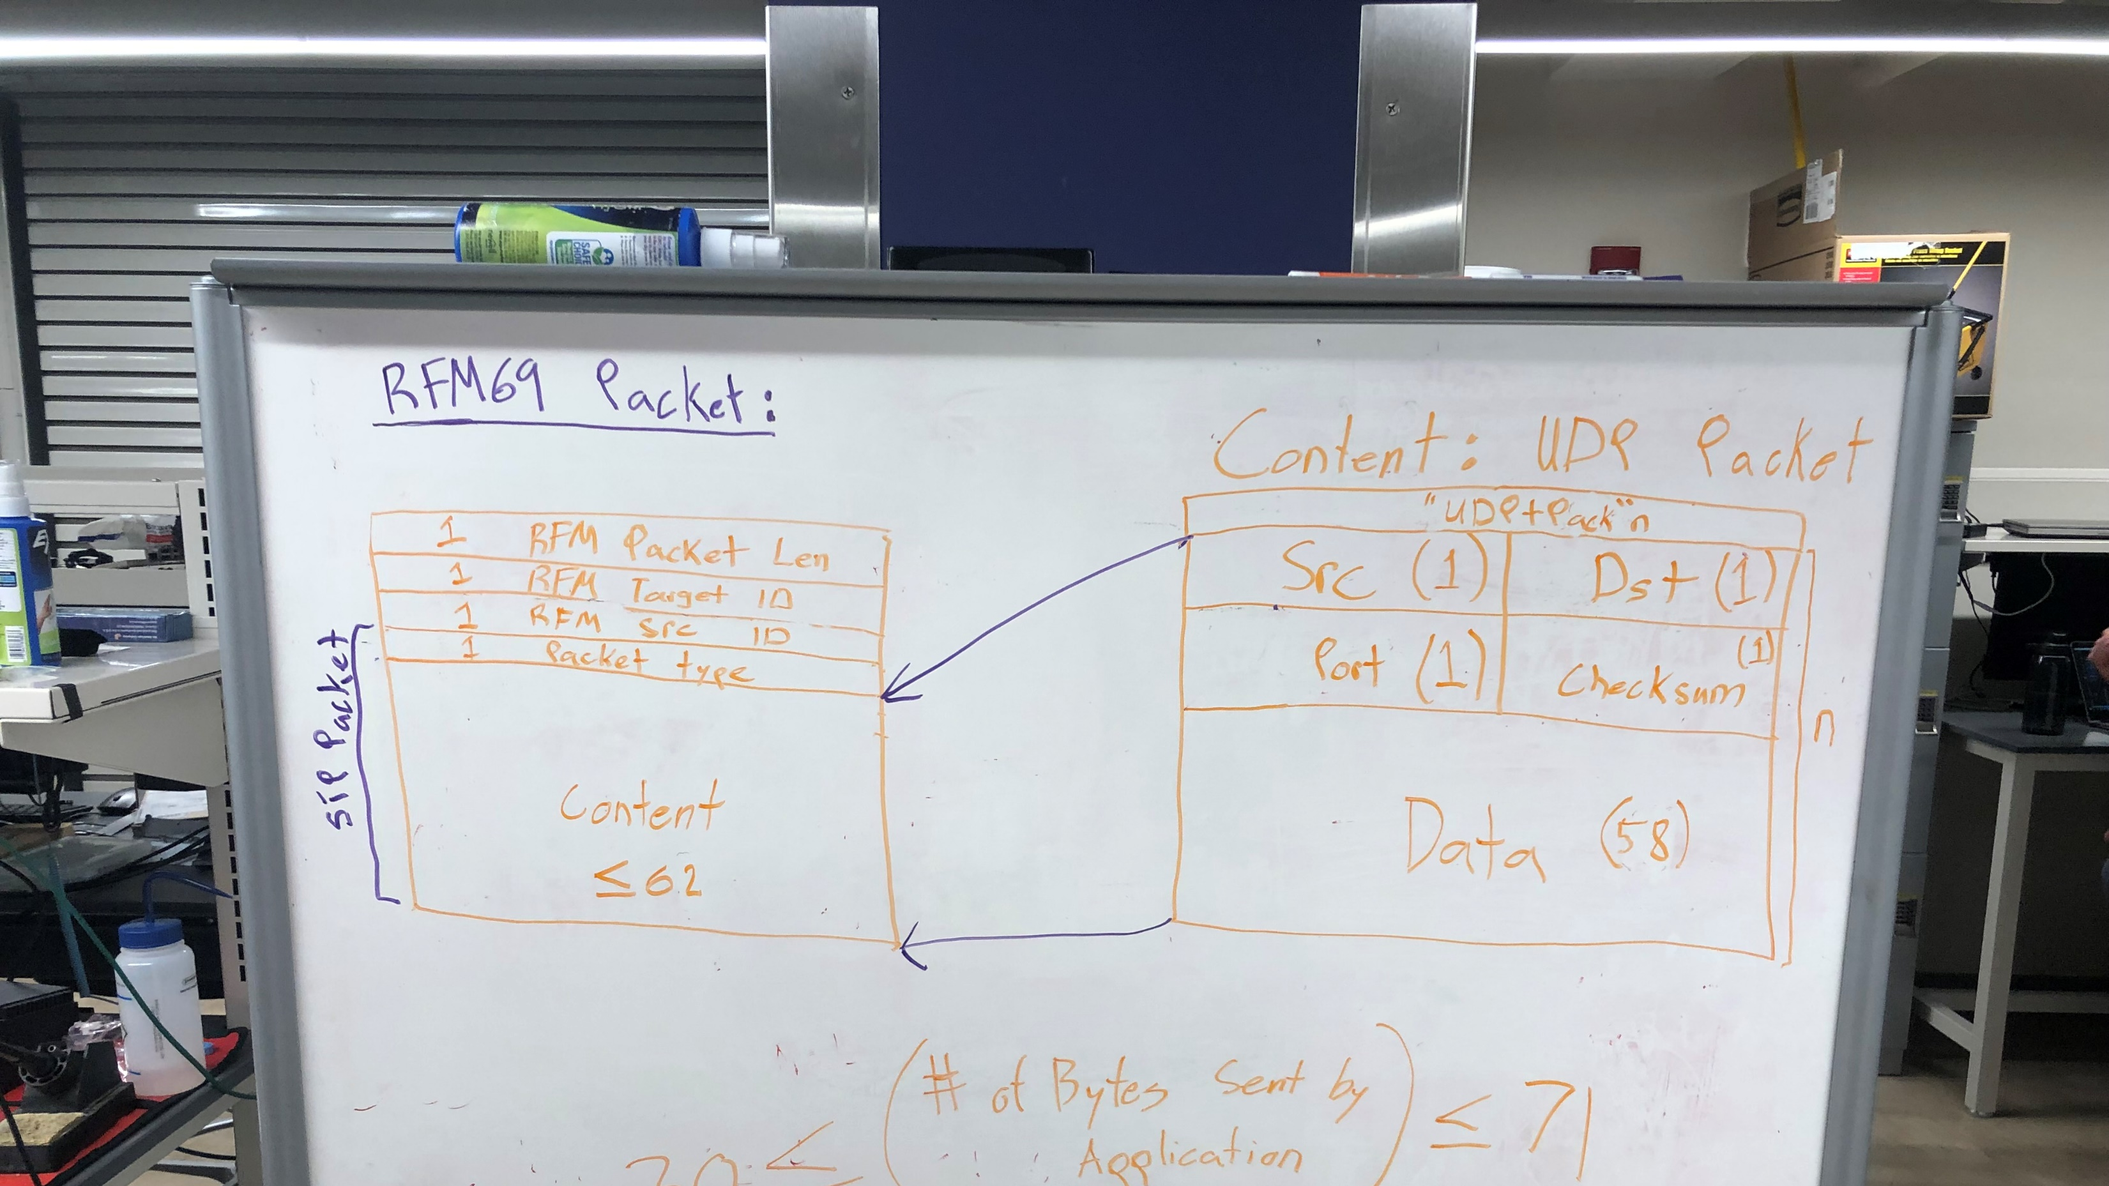

Slide 14
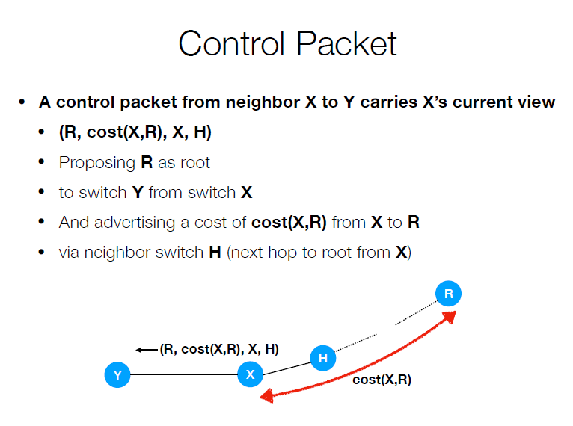
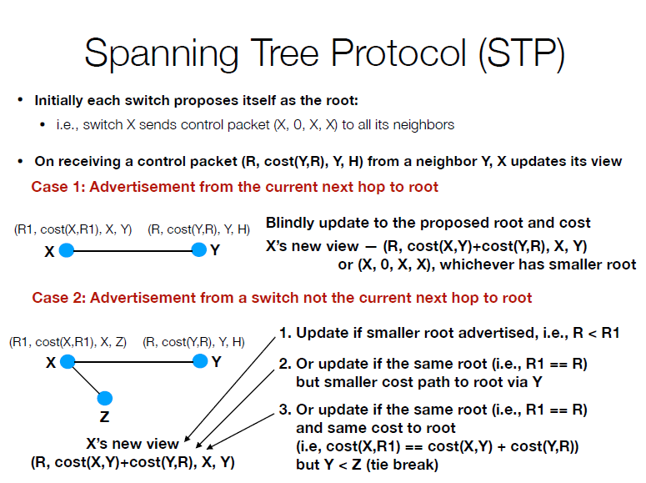
How is the network topology formed?

Slide 15
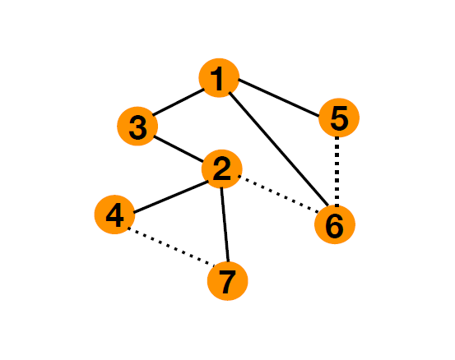


Slide 16
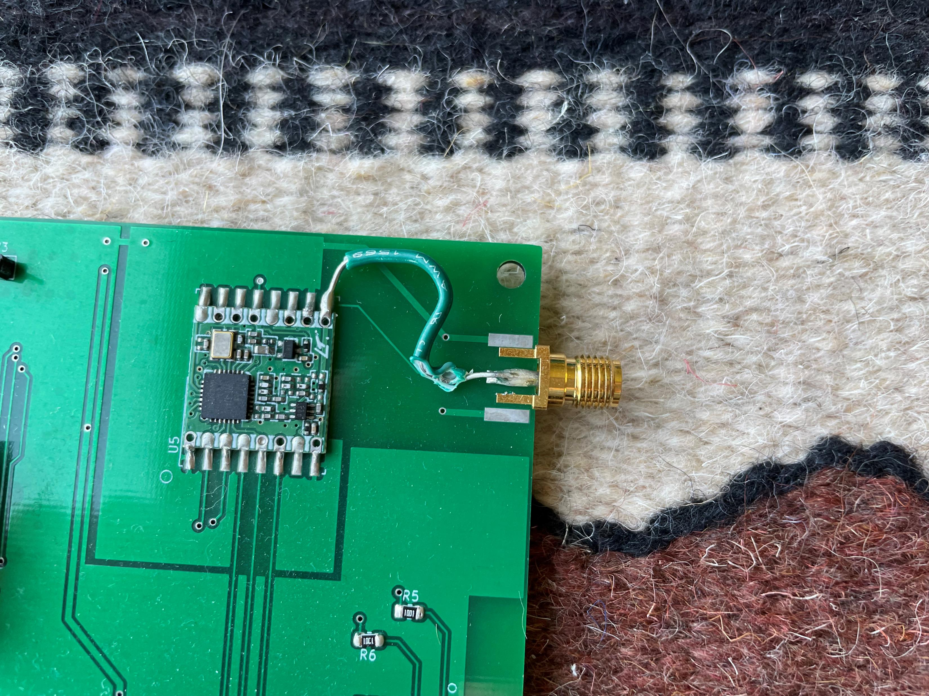
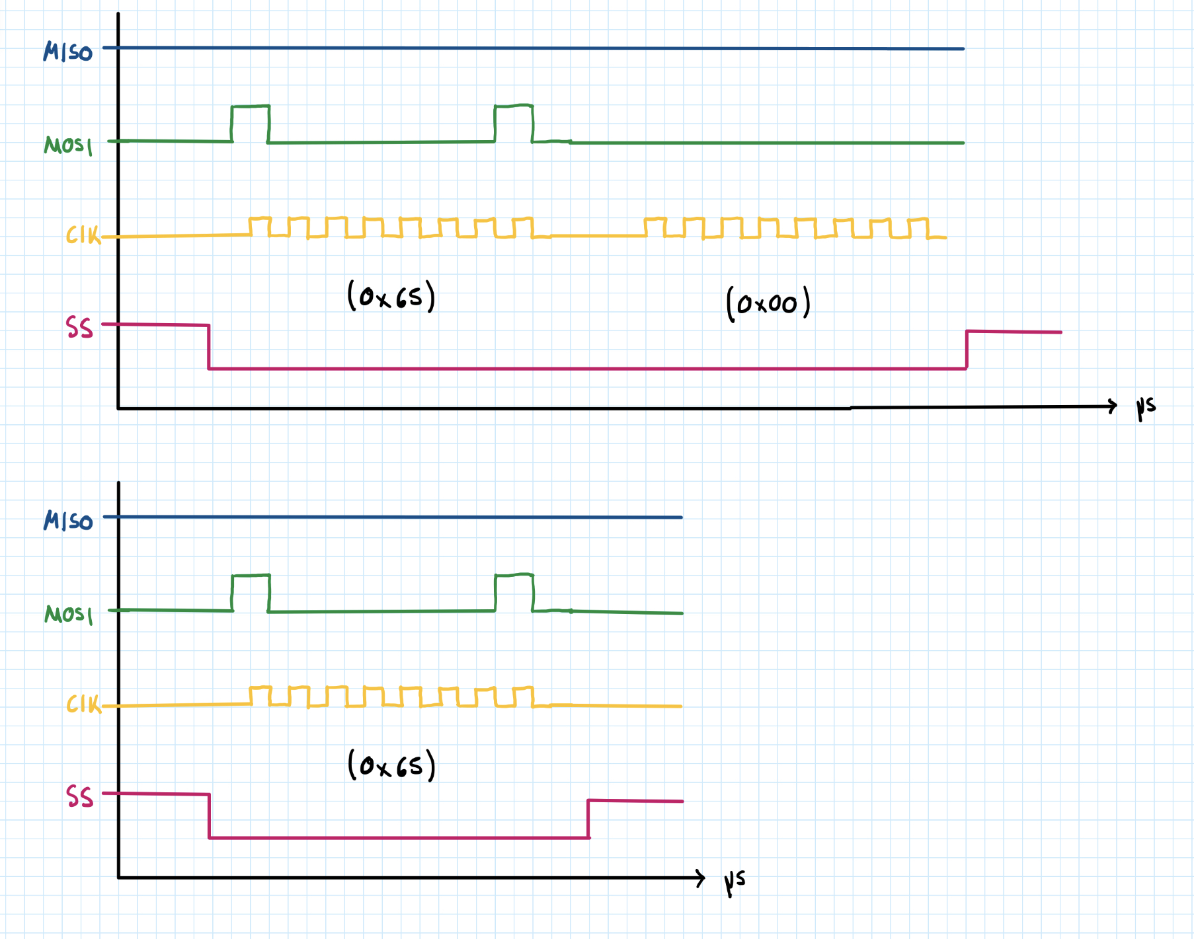
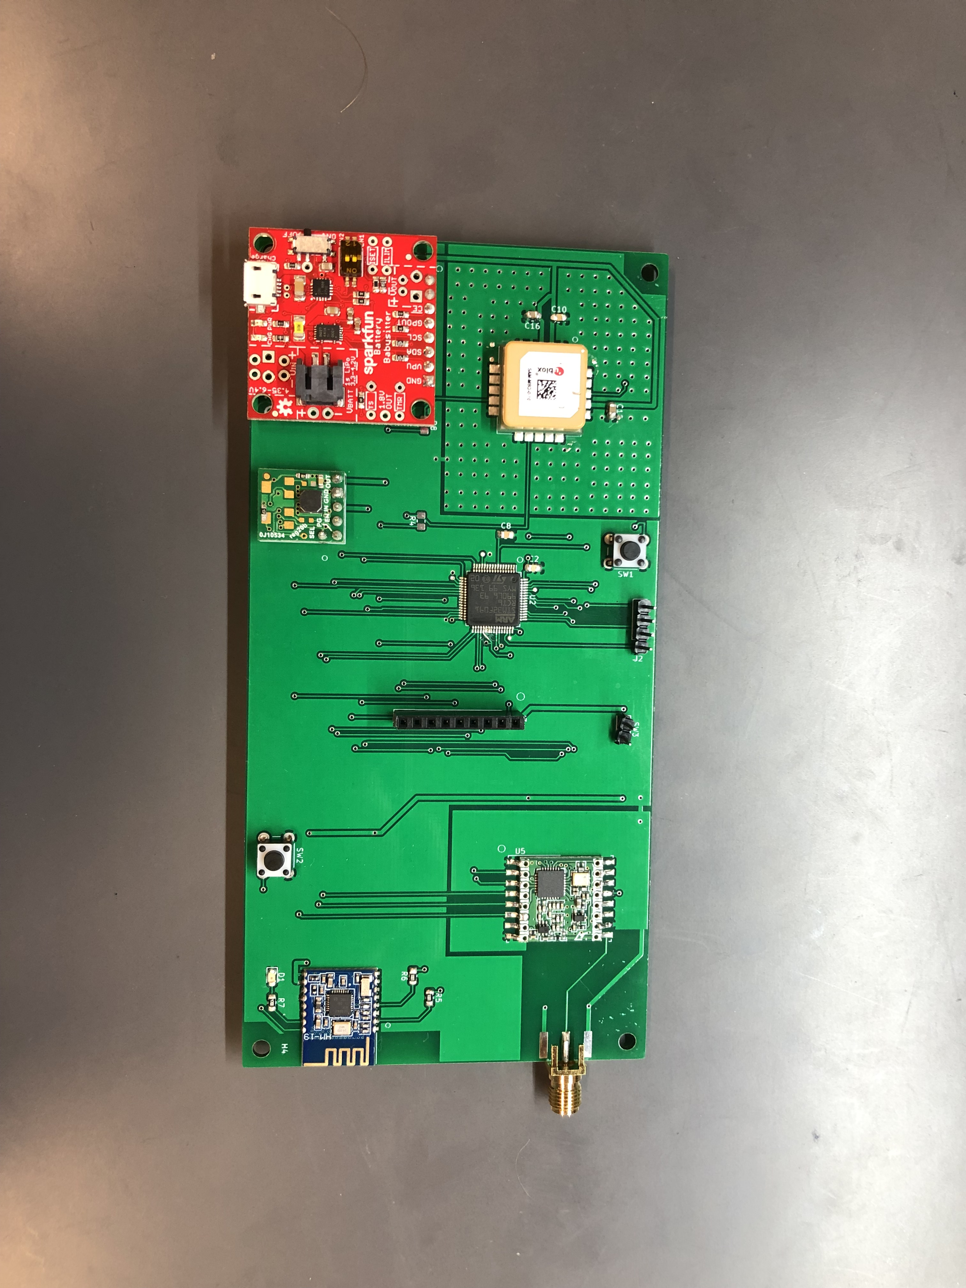
Design Challenges
Extra clock signal during SPI transmissions
RFM69HCW interface
UART Clock
RFM69 Antenna Trace
GPS I2C bridge
Packaging Design

Slide 17
Questions?

